Slide 1

Multithreaded Programming for Mere Mortals
Emery Berger, Charlie Curtsinger, Tongping Liu University of Massachusetts, Amherst

Slide 3
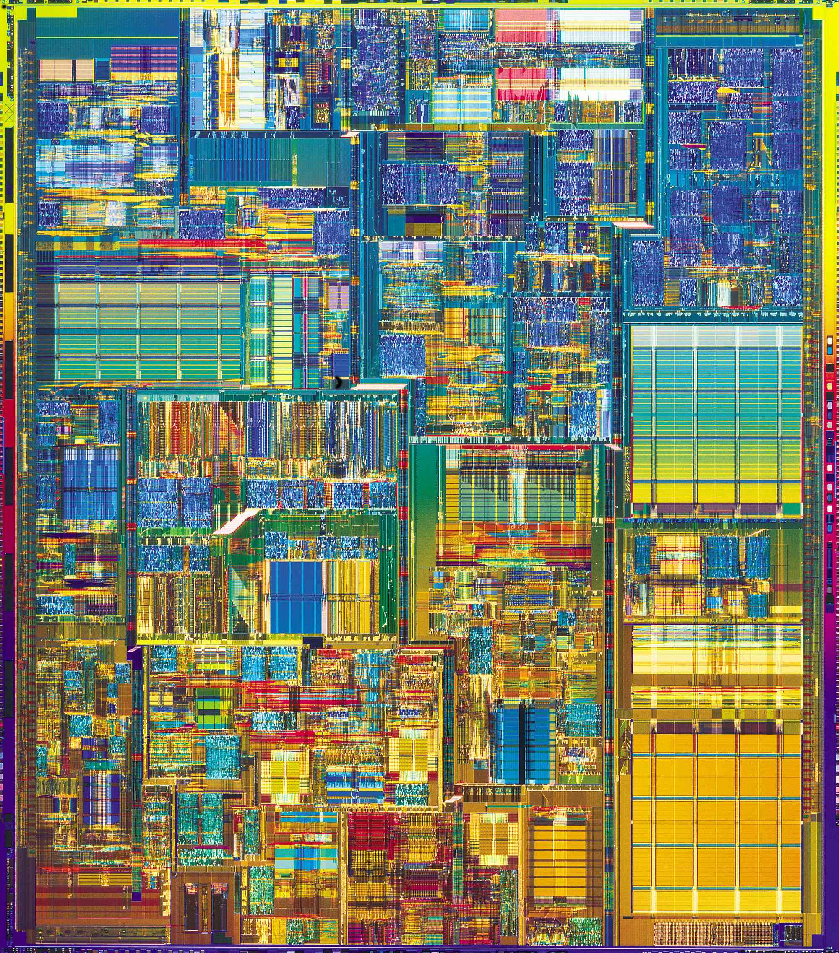
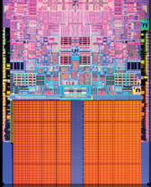

Slide 6


Slide 7


Slide 9
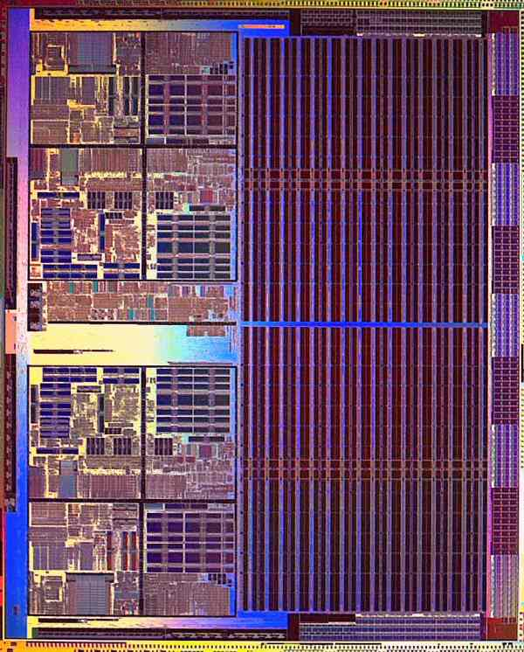

Slide 10
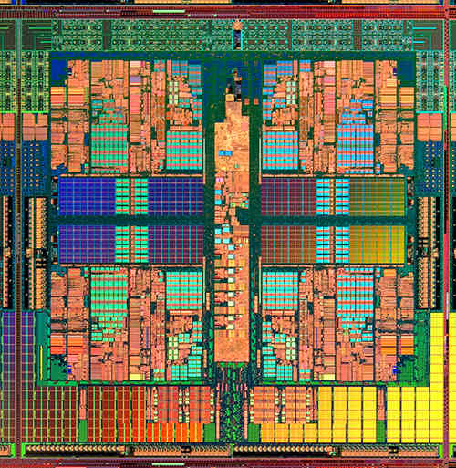

Slide 14
color = ; row = 0; // globals
void nextStripe(){
for (c = 0; c < Width; c++) {
drawBox (c,row,color);
}
color = (color == )?  : ; row++;
}
for (n = 0; n < 9; n++) {
spawn nextStripe();
}
sync;

Slide 15

“
”

Slide 16
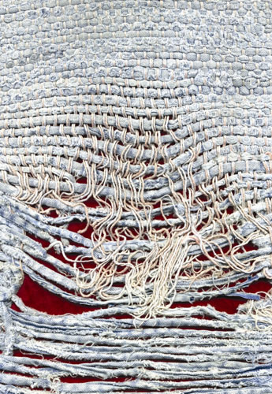
Notes:
Too few threads

Slide 17
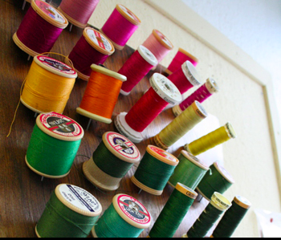
Notes:
Too many threads

Slide 18


( )
Notes:
contention

Slide 19
Notes:
One big lock

Slide 20
Notes:
Fine-grained locks (lock acquisition overhead)

Slide 21

False Sharing!
Notes:
Insidious!

Slide 22
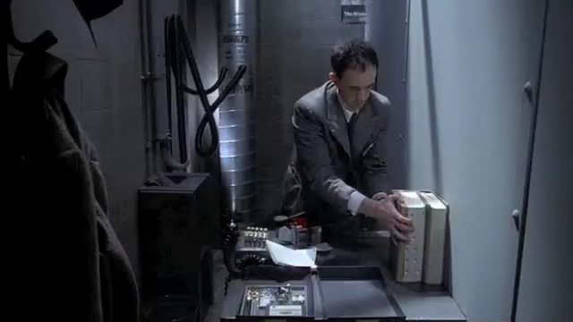
Notes:
(Brazil – didn’t know the desk was shared!)

Slide 23

mine!
yours!
cache line

Slide 24
me = 1;
you = 1; // globals
me = new Foo;
you = new Bar; // heap
class X {
int me;
int you;
}; // fields
arr[me] = 12;
arr[you] = 13; // array indices

Slide 25
Previous Tools
Instrument every access
200X slowdown, false positives
Performance counters
Fast but imprecise, false positives

Slide 26
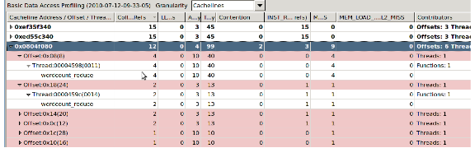

+ 850 lines…

Slide 27

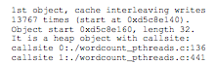
Precise
No false positives
FS-Detective
Identifies heap objects by callsite, globals by name

Slide 28


Slide 29

t1 = spawn f(x);
t2 = spawn g(y);
sync;

Slide 30

t1 = spawn f(x);
t2 = spawn g(y);
sync;
if (!fork())
f(x);
if (!fork())
g(y);

Slide 31

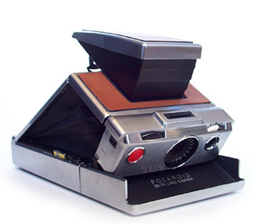

Slide 32


Slide 34
X
Y
for (i = 0; i < M; i++)
{
x = 1;
}
for (i = 0; i < M; i++)
{
y = 2;
}

Slide 35
X
Y
0
0
0
0
for (i = 0; i < M; i++)
{
x = 1;
}
for (i = 0; i < M; i++)
{
y = 2;
}

Slide 36
X
Y
0
0
0
0
1
0
for (i = 0; i < M; i++)
{
x = 1;
}
for (i = 0; i < M; i++)
{
y = 2;
}

Slide 37
X
Y
0
0
0
0
1
0
0
2
for (i = 0; i < M; i++)
{
x = 1;
}
for (i = 0; i < M; i++)
{
y = 2;
}

Slide 38
X
Y
0
0
0
0
1
0
0
2

Slide 39
X
Y
0
0
0
0
1
0
0
2
1
0

Slide 40
X
Y
0
0
0
0
1
0
0
2
1
0

Slide 41
X
Y
0
0
0
0
1
0
0
2
1
2

Slide 42
X
Y
0
0
0
0
1
0
0
2
1
2

Slide 47


Slide 48


Prevents all false sharing
FS-Patrol

Slide 49
X
Y
0
0
0
0
1
0
0
2
for (i = 0; i < M; i++)
{
x = 1;
}
for (i = 0; i < M; i++)
{
y = 2;
}

Slide 51
false sharing detection
original program
FS-Detective
FS-Detective

Slide 52
false sharing detection
use FS-Detective reports to guide modifications (padding, alignment)
original program
modified program
FS-Detective
libpthread
False Sharing!
FS-Detective

Slide 53
false sharing detection
use FS-Detective reports to guide modifications (padding, alignment)
original program
modified program
FS-Detective
libpthread
False Sharing!
FS-Detective
no false sharing
original program
libpthread

Slide 54
false sharing detection
use FS-Detective reports to guide modifications (padding, alignment)
original program
modified program
FS-Detective
libpthread
False Sharing!
FS-Detective
source code unavailable or insufficient resources to act on FS-Detective reports
no false sharing
modifications degrade performance or cause excess memory consumption
original program
original program
libpthread
FS-Patrol
false sharing mitigation
FS-Patrol

Slide 55


Slide 56


Slide 57


Slide 58


Slide 62
Dthreads
% g++ myprog.cpp –ldthreads –o myprog

Slide 63
race conditions
Dthreads
atomicity violations
deadlock
order violations

Slide 64
race conditions
Dthreads
atomicity violations
deadlock
order violations

Slide 65

race conditions
Dthreads
atomicity violations
deadlock
order violations

Slide 66
race conditions
Dthreads
atomicity violations
deadlock
order violations
deterministic

Slide 70


Slide 77
a b
a b
0 0
0 0

Slide 78
a b
a b
0 0
0 0
1 0
0 1

Slide 79
a b
a b
0 0
0 0
1 0
0 1
1 1

Slide 82
FS-Detective
FS-Patrol

Slide 83
FS-Detective
FS-Patrol

Slide 84
FS-Detective
FS-Patrol
Dthreads

Slide 85
FS-Detective
FS-Patrol
Dthreads
[OOPSLA 2011]
[SOSP 2011]

Slide 86
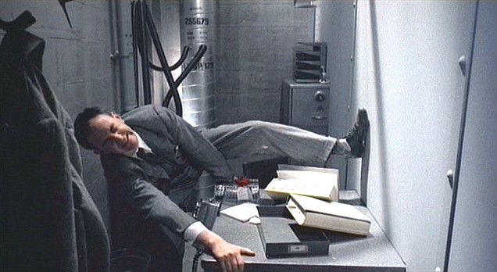
Notes:
(Brazil – didn’t know the desk was shared!)

